Slide 1
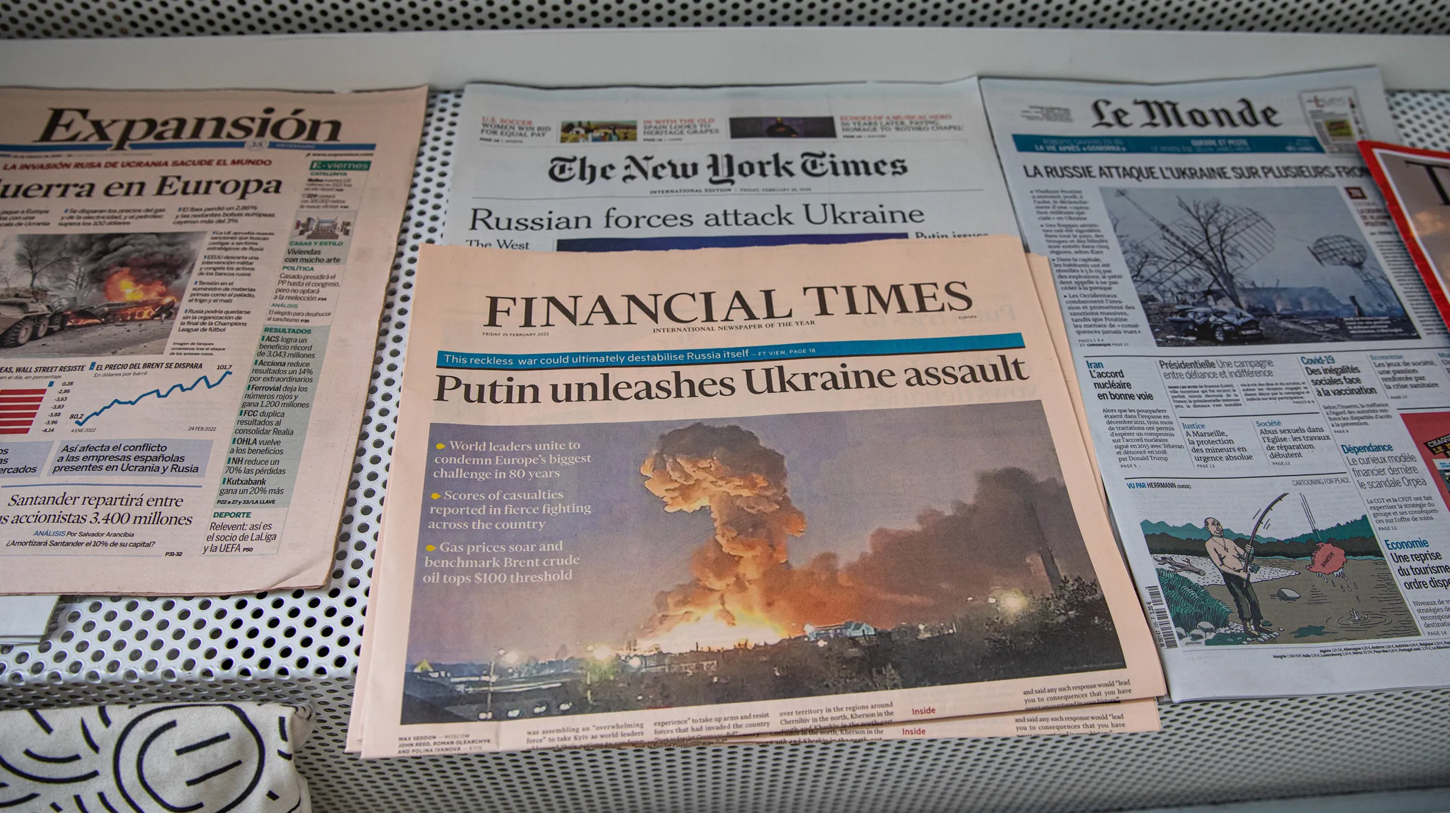
Ukraine War Sentiment Analysis
IS737 | Group 3
By: Nishant Nadkarni, Harsh Khatri & Nirbhay Malhotra

Slide 2



Team
Nishant Nadkarni
Harsh Khatri
Nirbhay Malhotra

Slide 3
Disclaimer
The following presentation is an analysis of the sentiment expressed by individuals and entities in various countries regarding the Ukraine crisis. It is important to note that this analysis is based on publicly available data and does not necessarily reflect the views or opinions of the presenter or any organization they may be affiliated with. The analysis of sentiment towards the Ukraine conflict should be viewed as a broad overview rather than a comprehensive assessment. The goal of this presentation is to provide insights and encourage further discussion on this complex and sensitive topic.

Slide 4
Introduction

Slide 5
Task
Analyze twitter data from March 2022 related to the Russia-Ukraine war
Analyze sentiment of each country towards the war

Slide 6
Dataset
Dataset sourced from kaggle [1]
75M+ datapoints
65 languages
130+ countries
29 features
Major features: Username, Account creation date, Tweet text, Language, Location, Hashtags

Slide 7
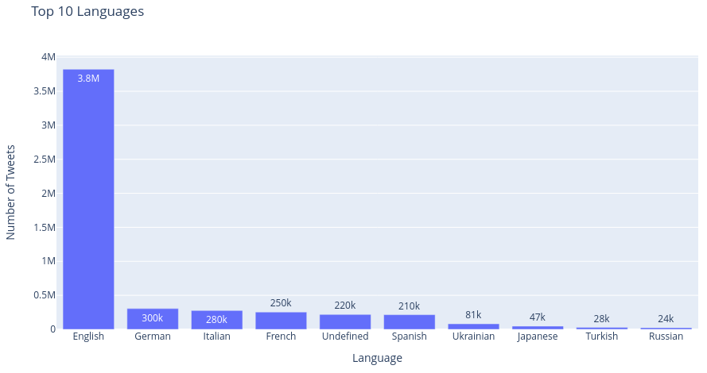
Dataset- Languages
* Data from first 2 weeks of the war

Slide 8
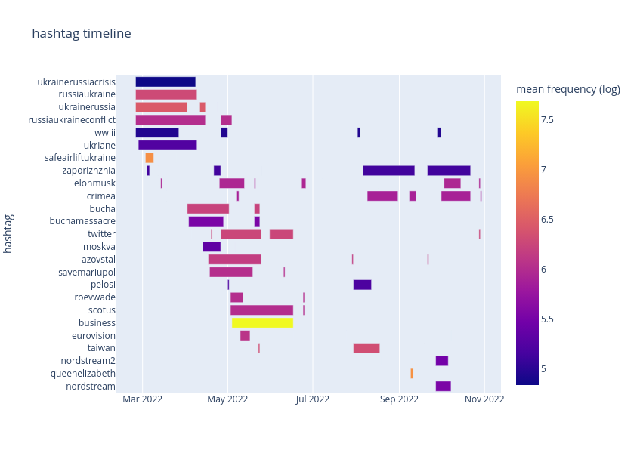
Dataset - Hashtags

Slide 9
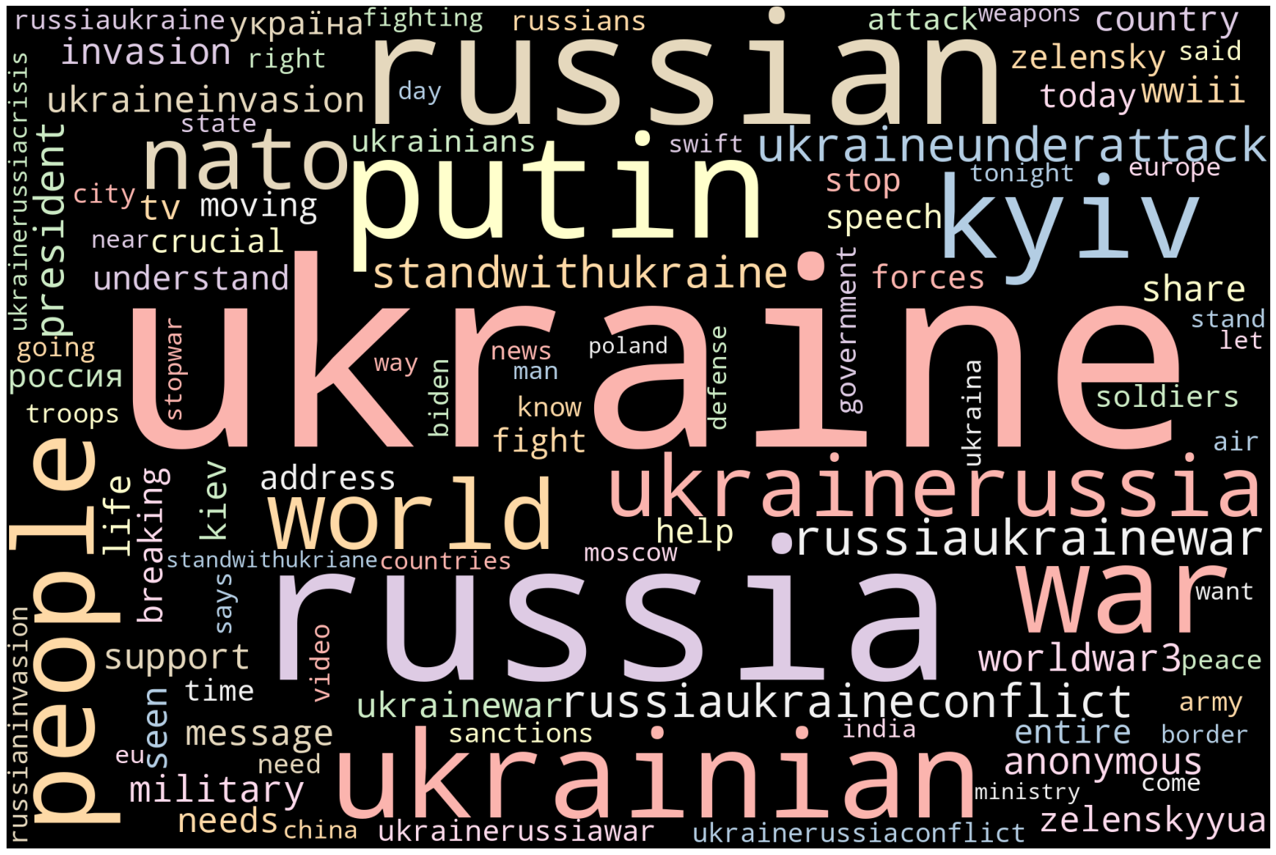
Dataset - WordCloud
* Wordcloud only for english tweets

Slide 10
Problems
Dataset size
Improper locations
Spam
50M+ datapoints.......
'CDMX'
'Up in ur timeline'
'Boston, MA'
'Global'
'old 2006 Twitter chap'
'C$192.5 - #FreeShipping | Time is Running Out BLACK+DECKER LLP120B Bare Max Lithium Ion #BLACKDECKER ?? https://t.co/onx5eYFcDn #sharious #canadianbestseller #canada #usa #product #20Volt #885911314589 #Alligator #Bare #BLACKDECKER . https://t.co/HLO0ydee80'

Slide 11
Preprocessing

Slide 12
Dealing with Dataset Size
Used data of 35 days
First 2 weeks of war (1st March 2022 – 14th March 2022)
Current month of war (1st April 2023 – 19th April 2023)
Used only 3 languages
English
Russian
Ukrainian
Dropped all columns with NaN in location or tweet text
Updated number of datapoints: 4.8M

Slide 13
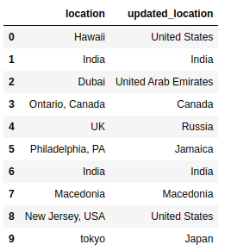
Dealing with Improper Locations
Used another kaggle dataset which contained cities, states and country data [2]
Changed all names of locations to standard country names and ISO3 codes using the countries dataset
Dropped all rows that didn't match any country
Updated number of datapoints: 2.7M
Previously KNN was used on co-ordinates

Slide 14
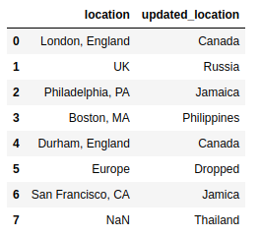
Problems
Places misclassified
Total processing time: 34 hours

Slide 15
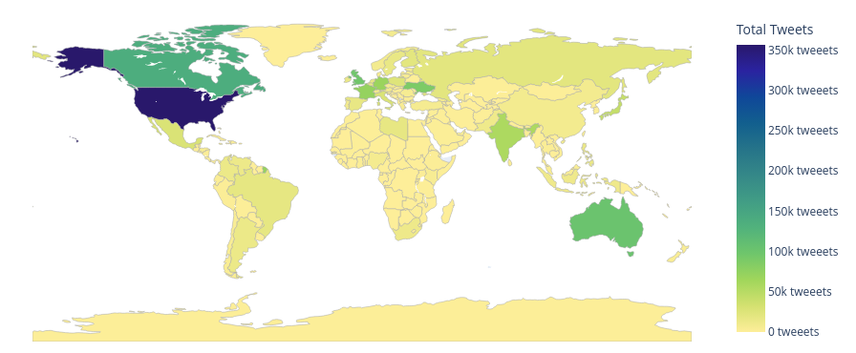
Country Wise Tweets

Slide 16
Spam Detection

Slide 17
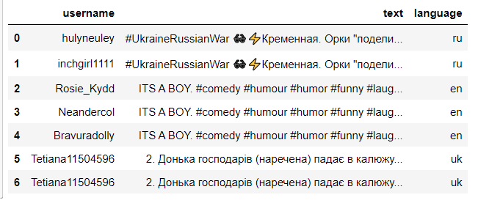
Dealing with Spam
Created a document using Spacy
Checked basic token similarity and removed data that was more than 95% similar

Slide 18
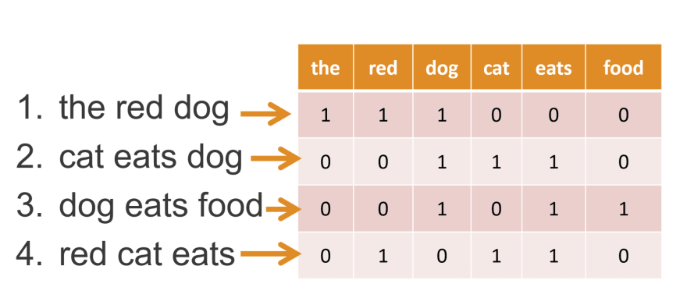
Bag Of Words
A way of representing text data
Simple to understand and implement
Language modeling
Document classification.

Slide 19
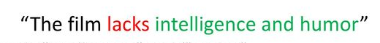
Limitations
Vocabulary requires careful design.
Context not preserved.
Takes only word frequency into consideration
Example:
"Hello, how are you?"
"How are you?, hello !"

Slide 20
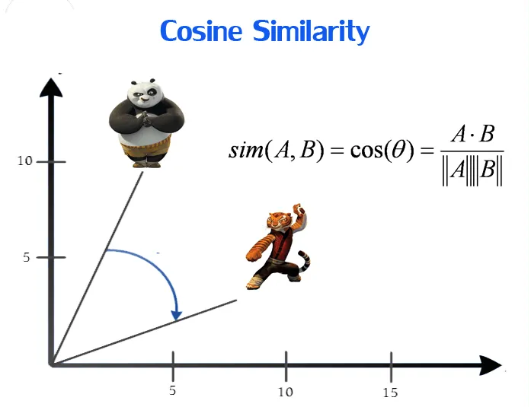
Word Embeddings
"Have a great day"
"Have a good day"
Have = [1,0,0,0,0]; a=[0,1,0,0,0] ;
good=[0,0,1,0,0] ; great=[0,0,0,1,0] ;
day=[0,0,0,0,1]

Slide 21
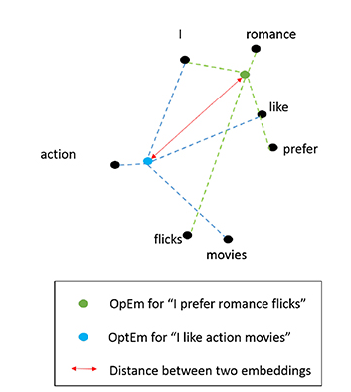
Word Embeddings
Input to the Neural Network be "Have a day".
Try to predict a target word "great".
Measure the output error compared to one hot encoding of the target word (great).
In the process, we learn the vector representation of the target word
Capable of word arithmetic - king - man + woman = queen

Slide 22
Spacy
Tokenization
Part-of-speech (POS) tagging
Named Entity Recognition (NER)
Dependency Parsing
Lemmatization
Text Classification
Word Vectors
Rule-based Matching
Sentiment Analysis

Slide 23
Spam Tweets
Document Similarity using Spacy.
Threshold = 97%
Natural Language Toolkit - English, Russia, Ukraine
Processed using GPU
Runtime: 12 hrs for 2 month data
Spam Detection using hugging face pre-trained model - High computation cost

Slide 24
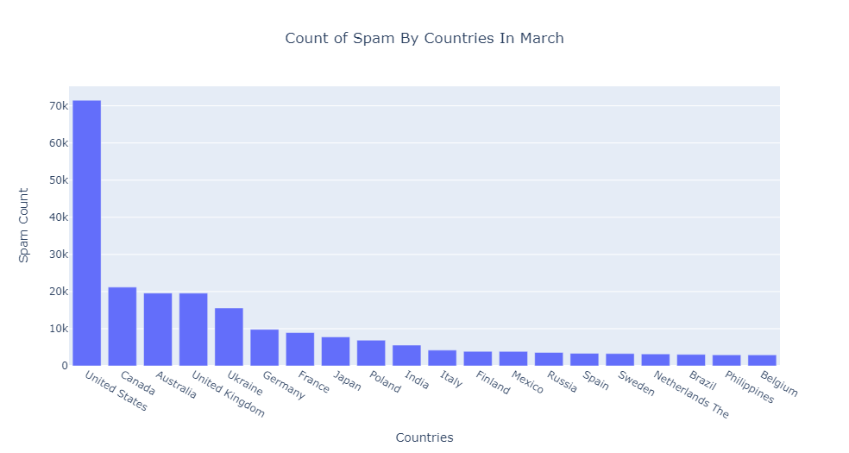

Slide 25
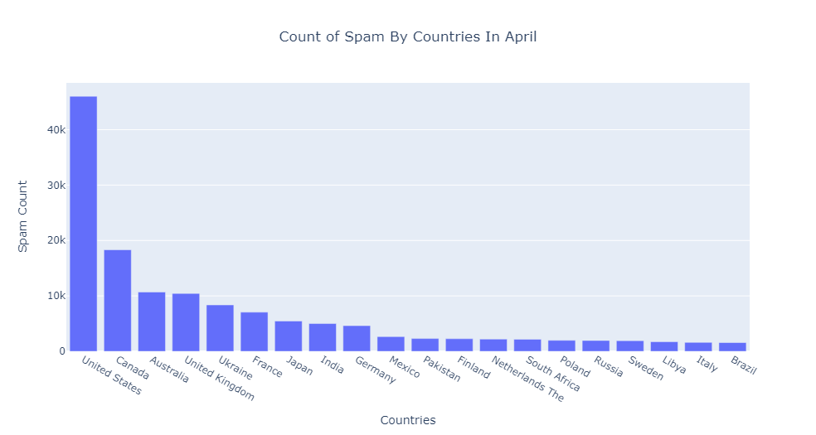

Slide 26
Sentiment Analysis

Slide 27
Sentiment Analysis - Introduction
Five Categories: pro-Russia, pro-Ukraine, against Ukraine, against Russia, or neutral
Entities : Famous cities, Famous People
Example : Zelensky, Putin, Kyiv, Moscow, Crimea, Bakhmut
The sentiment analysis can be broken down into two parts:
Textblob, used for calculating the sentiment score of each tweet
Transformer model that learns from entities, used for the classification of further tweets.

Slide 28
Sentiment Analysis - Steps
Tokenization: Text to the sequence of Tokens.
Padding: Token sequences are padded for the same length
Embedding: Token Sequences are mapped to continuous vectors representing high dimensional space.
Transformer Layers: Multi-Head Attention Layer and feed-forward layers for capturing complex dependencies between the words in the input sequence
Aggregation: A Global Average Pooling layer for aggregating the outputs of the Transformer layers, creating a fixed-size vector representation of the input sequence.
Prediction: Dense final layer is applied to the aggregated vector to generate the sentiment predictions (e.g., pro-Russia, pro-Ukraine, against-Russia, against-Ukraine, and neutral).

Slide 29
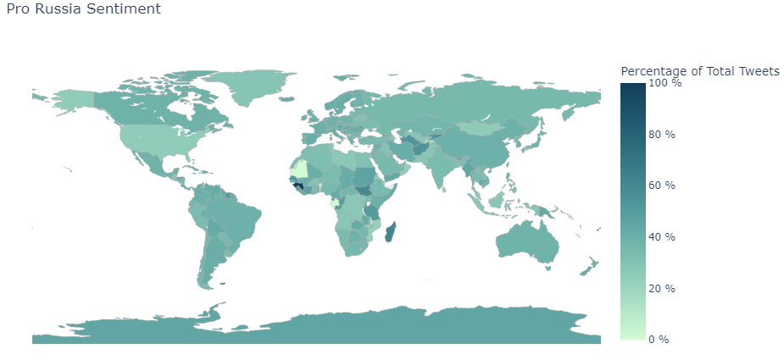
Pro Russia Graph

Slide 30
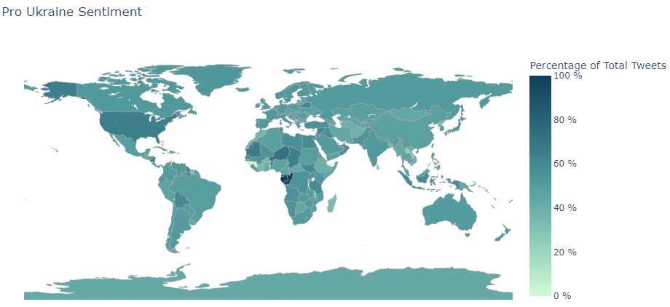
Pro Ukraine Graph

Slide 31
Analysis and Recommendations

Slide 32
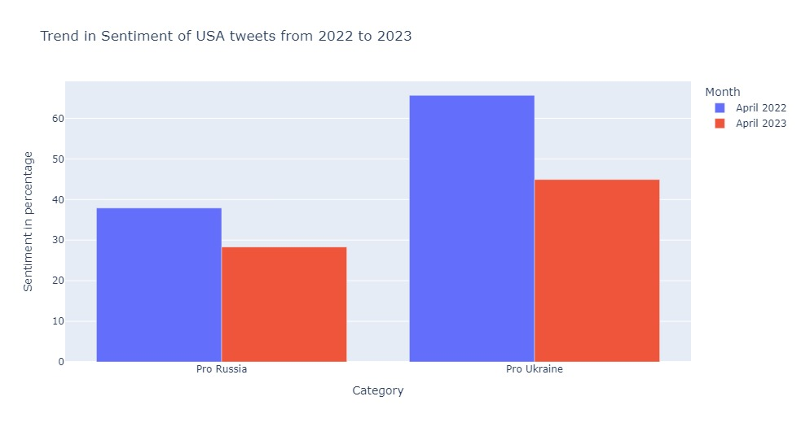
USA (Towards 2024 elections)
Significant drop in Pro Ukraine Sentiment
Slight drop in Pro Russia sentiment
Overall population seems to be tending towards peace
Based on public sentiment, the US government should focus on a peace deal in Ukraine rather than focusing on arms shipment

Slide 33
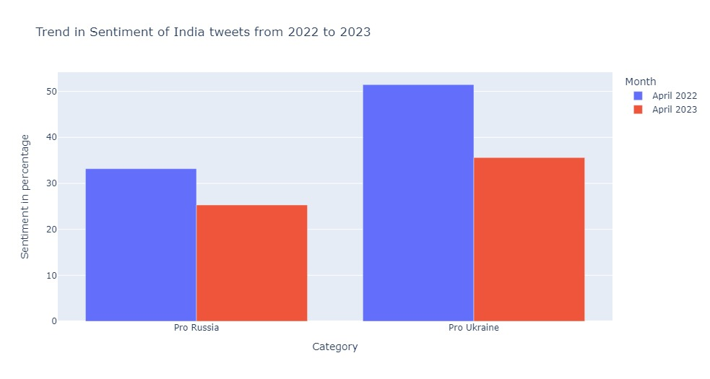
India (Towards 2024 elections)
Significant drop in Pro Ukraine Sentiment
Slight drop in Pro Russia sentiment
Overall population seems to be tending towards Ukraine and peace
Based on public sentiment, the Indian government should focus on peace while ramping up support humanitarian support for Ukraine

Slide 34
References
[1] https://www.kaggle.com/datasets/bwandowando/ukraine-russian-crisis-twitter-dataset-1-2-m-rows/code?resource=download&select=0820_UkraineCombinedTweetsDeduped.csv.gzip
[2] https://www.kaggle.com/datasets/tanweerulhaque/countries-states-cities-dataset

Slide 35

Questions
Thank you for listening

